Slide 1
Using SQL for large-scale healthcare claims data as a Research Data Scientist
Emily Tang

Slide 2

Who I am
Research Data Scientist at Proctor Foundation
Proctor Foundation is an internationally renowned, privately endowed Organized Research Unit at UCSF.
Ophthalmology focused research in infectious and inflammatory ocular diseases

Slide 3
Day-to-day tools
SQL:
cohort identification, data extraction, data manipulation
SQL Functions:
CREATE TEMP TABLE
CASE WHEN
LEFT JOIN, INNER JOIN
UNION
SELECT * FROM (SELECT a, b FROM TABLE_A) tmp1 (Subqueries)
R: tidyverse (includes dplyr, ggplot2), glmnet, caret, survival

Slide 4
Research Questions I’ve worked on
Immunosuppression on COVID-19 outcomes in non-infectious uveitis patients, and in the general population
Comparing CDC/public data vs claims data
Herpes zoster vaccination and incidence of dementia

Slide 5
Background
Herpes zoster (HZ aka shingles), is caused by reactivation of varicella-zoster virus (VZV) that results in a painful rash
Herpes Zoster Ophthalmicus (HZO) is HZ with involvement of the fifth cranial nerve (trigeminal nerve), shared by the eye and ocular adnexa
Standard treatment involves antiviral medications
Notes:
antivirals: Famciclovir, valacyclovir, acyclovir
https://www.cdc.gov/shingles/hcp/clinical-overview.html
https://eyewiki.aao.org/Herpes_Zoster_Ophthalmicus
https://www.aao.org/eyenet/article/herpes-zoster-ophthalmicus-pearls
https://healthmatch.io/shingles/shingrix-vs-zostavax#overview
https://www.cdc.gov/vaccines/vpd/shingles/public/zostavax/index.html

Slide 6
Data
Optum Labs Data Warehouse (OLDW):
A de-identified healthcare claims database + EHR data
> 200 million lives of US patients enrolled in commercial insurance, Medicare Advantage or Medicare Part D since 1994.
Comprehensive, longitudinal view of patients’ claim history (medical + pharmacy claims)
ICD-10 code examples (Dementia):
F00.xx, Dementia in Alzheimer disease F01.xx, vascular dementia F02.xx, dementia in other diseases classified elsewhere F03.xx, unspecified dementia F05.1, Delirium superimposed on dementia, senile dementia with delirium | G30.x Alzheimer’s disease G31.0 Circumscribed brain atrophy, includes frontotemporal dementia, pick’s disease G31.1 Senile degeneration of the brain, not elsewhere classified G31.8 Other specified degenerative disease of the nervous system. Includes Lewy body dementia Dementia with Parkinson’s codes: G31.83, F02.x

Slide 7
What we see
Medical Claims: Date, ICD type, diagnosis codes, procedure codes
Pharmacy Claims: Date, NDC Code, Quantity, Days Supply, Dose, Generic Name, Brand Name, Paid Amount
ID | Date | ICD_type | Diag_code | Diag_desc | Proc_code | …
123 | 6/14/23 | ICD-10 | G31.0 | Senile degeneration of the brain | NA | …
999 | 3/2/21 | ICD-10 | F03.A | Unspecified dementia, mild | NA | …
ID | Date | NDC_code | Days_supply | Dose | Brand_name | Generic_name | …
123 | 3/1/19 | 1231231 | 30 | 200mg | Keytruda | Pembrolizumab | …
999 | 3/2/21 | 0009999 | 90 | 1000mg | Rituxan | Rituximab | …
Everything shown here is just for examples and not medically accurate

Slide 8
When we use SQL
Extract claims with relevant ICD-10 codes, procedure codes, or drug names/codes.
Apply inclusion/exclusion criteria to get cohort
Extract cohort characteristics and form dataset to work with
Data manipulation
Feature engineering: the process of selecting, manipulating and transforming raw data into features for model input/analysis
Data cleaning: fixing/removing incorrectly inputted or formatted, duplicated, or incomplete data
More data transformation done in R
Notes:
Awesome examples. Okay to define each? We’ll have just done some cleaning with pandas, but feature eng is coming up the lecture after SQL. Also, reasonable to work up fake data and SQL for each in a notebook for after the slides?

Slide 9
Storing intermediate results
Common Table Expressions (CTEs):
Only valid in the same query
Better readability
Temporary Tables
Exist for entire session or until dropped
Have access to indices and statistics such as # of distinct values, NULLs, or distribution of values.

Slide 10
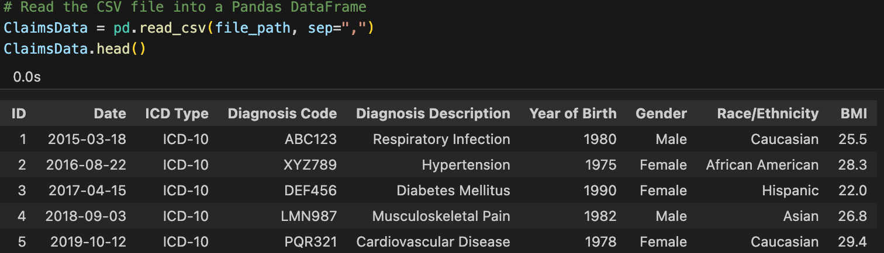
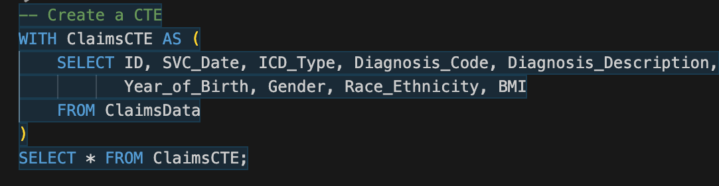
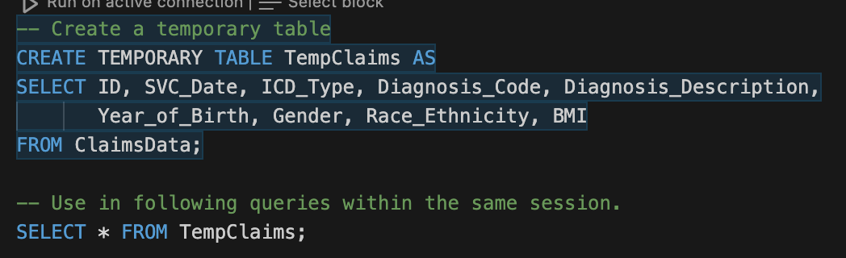
Example Claims Data
Common Table Expression (CTE)
Temp Table

Slide 11
Joins
I really only use left join (left outer join) and inner join
If you need unmatched rows in the primary table, use a left join
If you want to keep IDs/rows in primary table, though Table B may not have corresponding values
If you don’t need unmatched rows, use an inner join.
If you want to keep IDs/rows present in both primary table and Table B.
Full outer join: if you want to keep all the info from both tables
Right join/right outer join: Similar to Left Join, but keeping stuff from right table/table B instead.

Slide 12
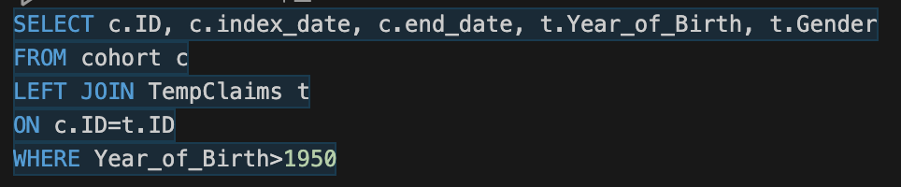
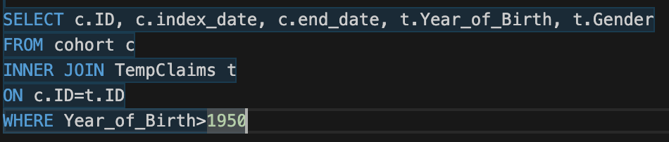
Joins
- Want to keep everyone in the cohort (LEFT Join)
- Want to keep everyone in the cohort and claims data (JOIN aka INNER Join)

Slide 13
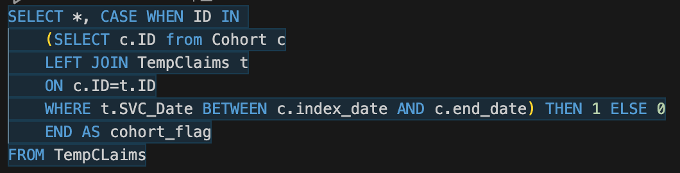
Subqueries
A subquery is a query that is nested inside another query
Used to add a new column to the main query result, to create a filter, or to create a consolidated source to select the data from

Slide 14

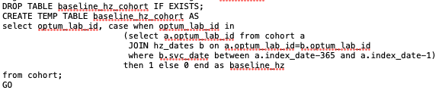
SQL code examples from my work
Notes:
Data transformation, filtering, subqueries
Like what I think you’re trying to show here but not quite following from the code (where is the temp table used?). Okay to modify the code for clarity? Maybe show the same process using a temp table vs CTE?

Slide 15
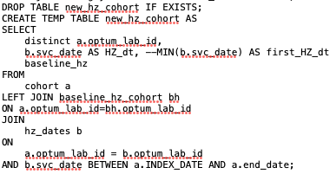
Notes:
Nice, multiple joins of different types. Ready to talk through left vs right vs (implied) inner join vs full outer? When to use each?
Also Union ?

